Slide 1
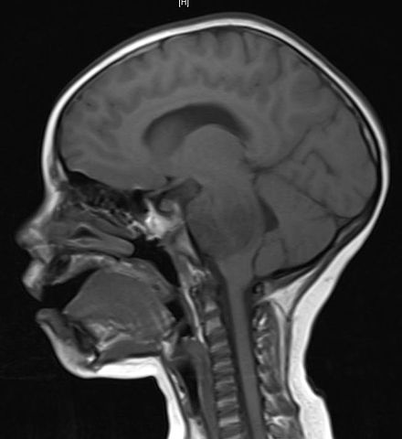
UNIVERSITY OF NEW HAVEN
FALL 2022
BRAIN TUMOR DETECTION
Presented By,
Sai Krishna Chejarla - 00750120
Sowmya Kotha - 00757280
Sudheer Kothapalli – 00763797
Vidya Kallur Sudheendra - 00751595
Led By,
Dr. Shivanjali Khare

Slide 2
PRESENTATION AGENDA
Overview
Project Objectives
Approach
Deliverables
Evaluation Methodology
Conclusion

Slide 3
Overview
Brain Tumor is a mass of cells that have grown and multiplied uncontrollable. Medical imaging plays a central role in the diagnosis of brain tumors.
MRI is a technique used in medical imaging which is considered to be the most efficient tool to analyze the internal structures of the body.
Since brain tumors vary in size, shape, appearances, color, location and orientation, which is precisely the reason why tumor segmentation is challenging.
The major drawback of manual detection is that it is time consuming and prone to human errors.

Slide 4
Project Objectives
Build and tune a model that will take MRI scan of brain and patient details as input and preprocess the images read from the database. Perform segmentation in order to detect the ROI and extract the area and size of the tumor from ROI.
01
02
Provide a solution appropriately at early stages
03
Get timely consultation

Slide 5
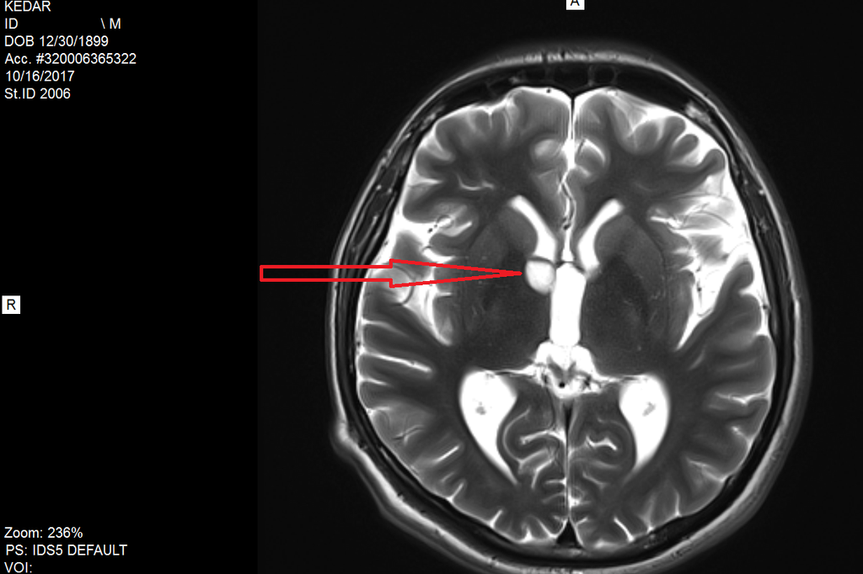

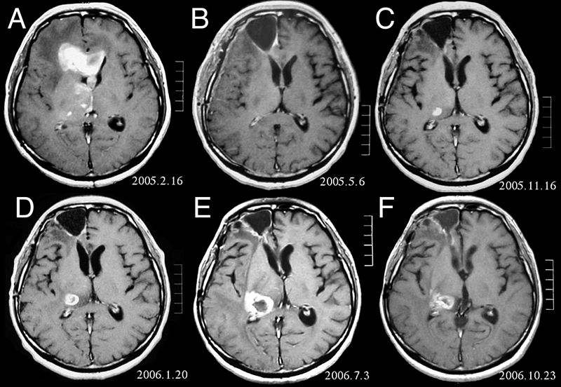
Approach
STEP 1: Find the dataset
STEP 2: Find a model
STEP 3: Sampling the model (Train and Test )
STEP 4: Execute the model
STEP 5: Summarize the results

Slide 6
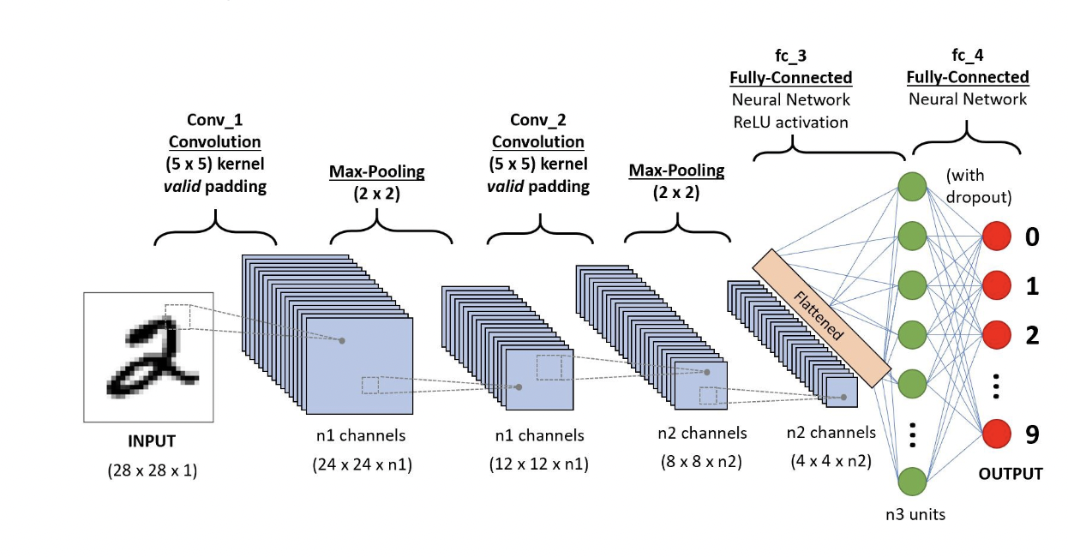
Convolutional Neural Networks
Convolutional Neural Network (CNN) is the deep learning technique to perform image classification.
The data will be sampled into train, test and validation sets using the train_test_split method from sklearn to divide them into 80% (train and validation) and 20% (test).
Once trained, the model will predict the results with better accuracy since CNN would have learned and tuned the parameters from the provided dataset.
In this project, we will build the CNN model and train it by inputting our data set so that the model can distinguish between
tumorous images and not-tumorous.

Slide 7
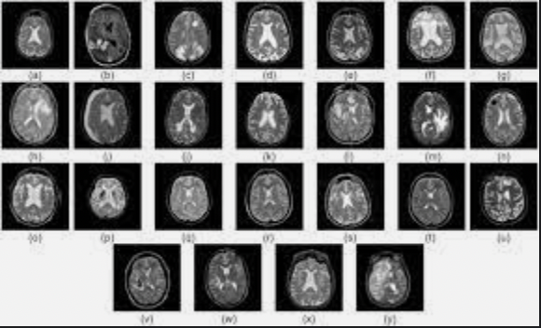
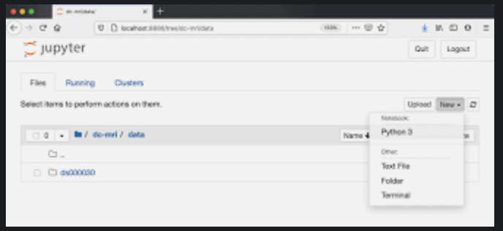
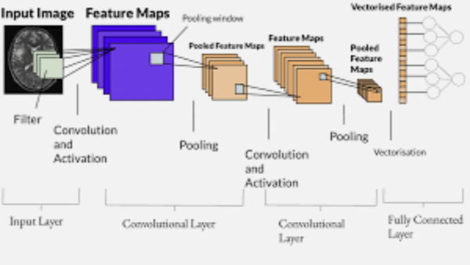
Deliverables
Dataset (MRI images)
Code (Jupyter Notebook)
Screenshot of the results after executing the model
Model after training

Slide 8
Evaluation Methodology
04
Introduce data into the CNN model with fully connected layers
Calculate the performance measure and tune the model accordingly.
01
03
Describe the parameters in the model.
Train and Evaluate the model while looking for improvements.
02

Slide 9
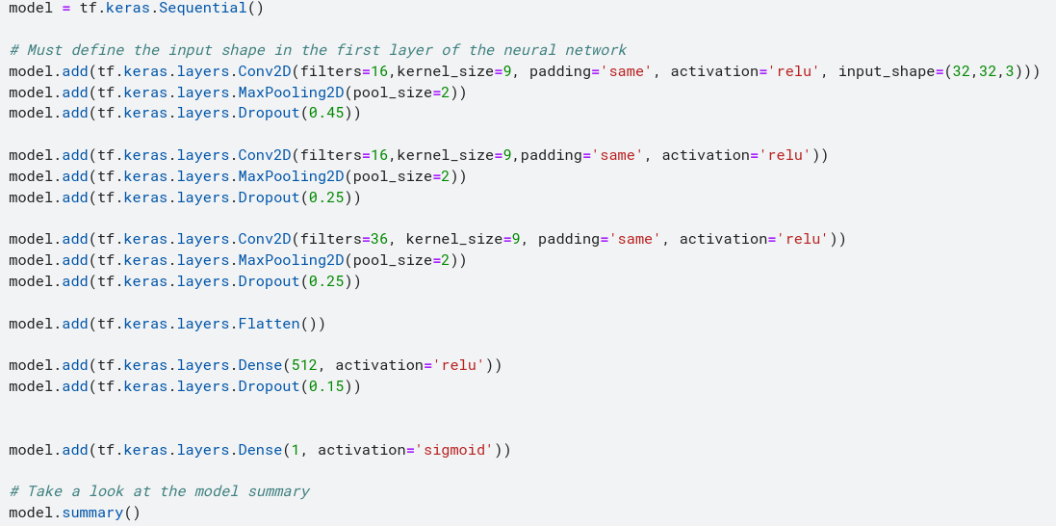
The model below was produced via CNN with fully connected layers .

Slide 10
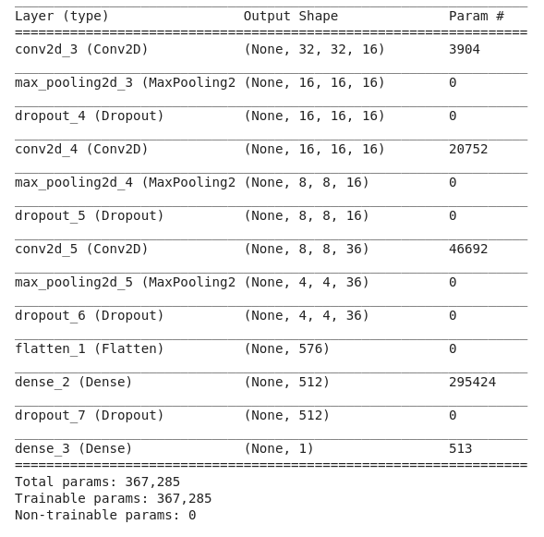
Result for the model summary, which shows our model in detail and lists all the model's parameters.

Slide 11
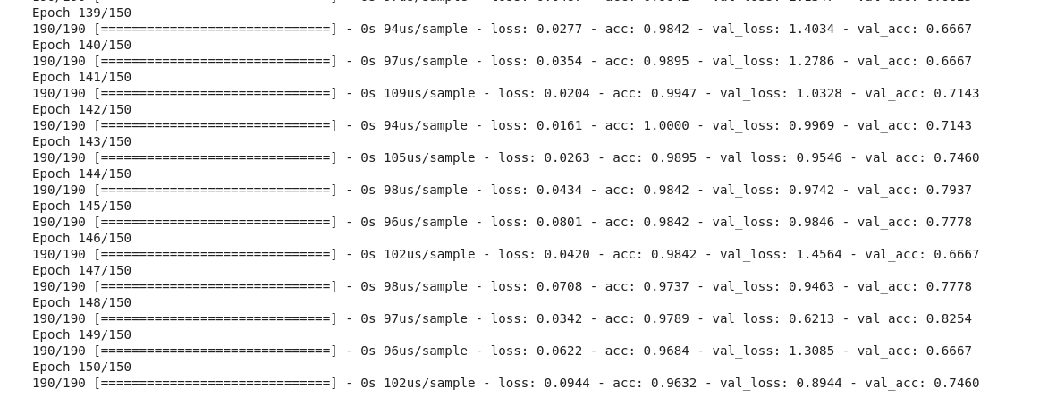
As shown below, we begin training our model for 190 iterations.

Slide 12
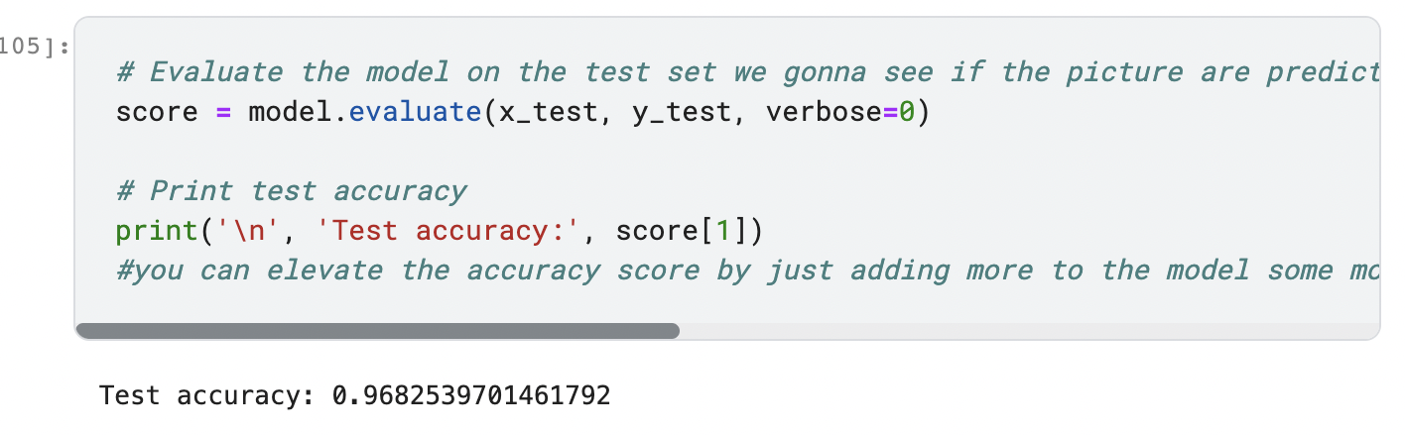
Evaluation Phase
After we've finished training our model, we go on to the evaluation phase, where we determine whether the model is good or whether it requires improvement.
As we can see the accuracy of our model is at 96% it is not that bad but its good and we can still improve this result by looking for a bigger DATASET

Slide 13
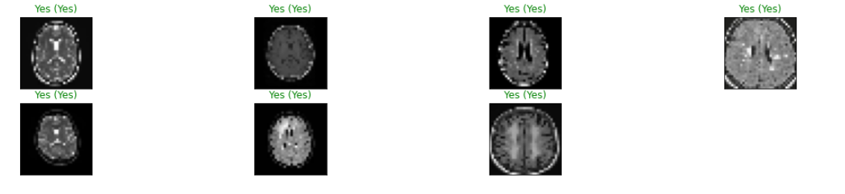
Some results for the model from test pictures
From the above we can say that our model gave pretty much good results.

Slide 14
Conclusion
The project is a combination of Convolutional Neural Networks and Computer Vision where the prior is used for prediction and the latter is to analyze the MRI scans.
The performance of this model will be better than VGG16 and Fuzzy NN, since CNN has better parameters to train and evaluate the model, which can be increased by model hyperparameter tuning.

Slide 15
Thank you!

